Slide 1


TransUAAE-CapGen: Caption Generation from Histopathological Patches through Transformer and UNet-Based Adversarial Autoencoder S M Taslim Uddin Raju, Abdul Raqeeb Mohammad, Md. Milon Islam, and Fakhri Karray
Presented by
Fakhri Karray
Department of Machine Learning
Mohamed bin Zayed University of Artificial Intelligence
&
Research Chair Professor Emeritus
Department of Electrical and Computer Engineering
University of Waterloo

Slide 2
Presentation Outline
Introduction
Contributions
Proposed TransUAAE-CapGen Architecture
Experimental Results Analysis
Conclusions
Applications and Future Works
References

Slide 3
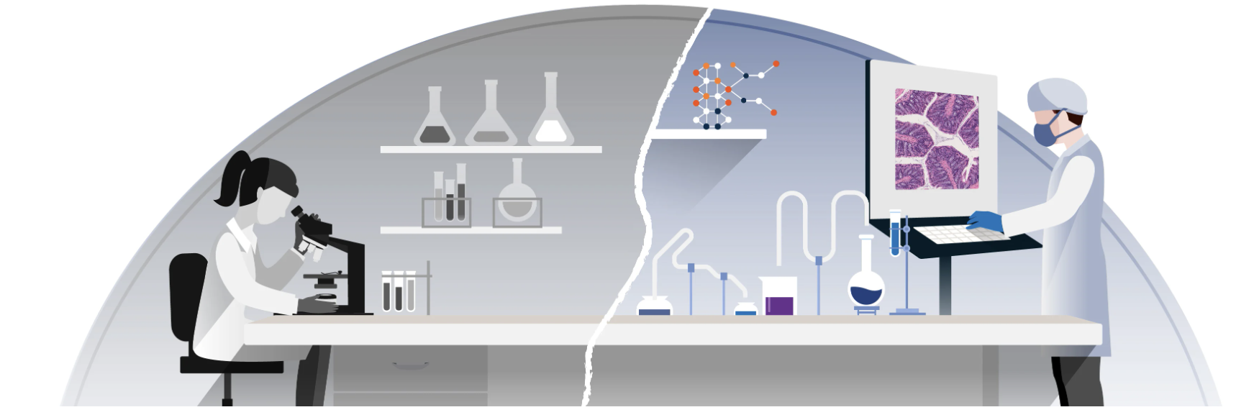
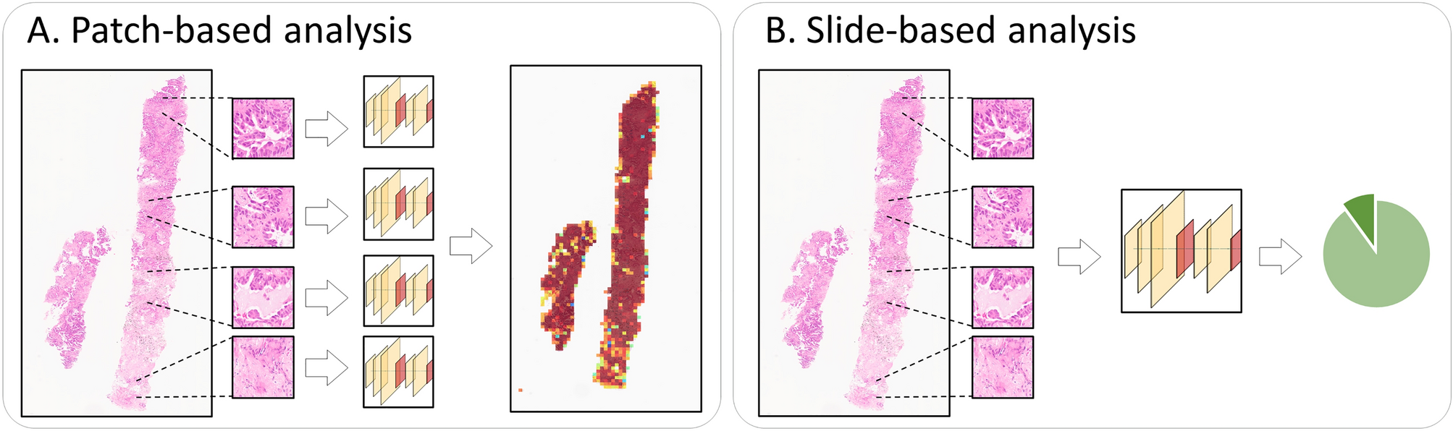
Introduction
Background
Histopathology is a vital field that involves studying the size, shape, and patterns in cells and tissues from a patient’s clinical records.
Histopathology can be analyzed either patch-wise or slide-based.
Histopathological captions are extracted from diagnostic reports and paired with image patches.
Automatic generation of diagnostic reports from whole slide images (WSI) would reduce pathologists' workload.
Fig.1. Digital pathology for image analysis¹.
Fig.2. (A) Patch-wise and (B) Slide-based histopathological analyses².
https://blog.crownbio.com/digital-pathology
Scientifc Reports 12 (2022) 19075

Slide 4
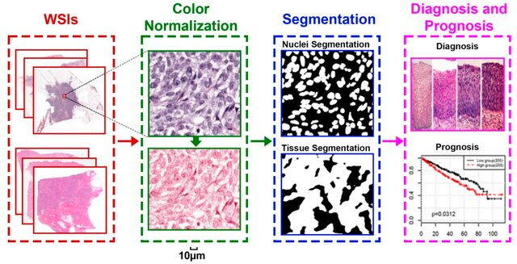
Introduction
Problem Statement
Deep learning models such as RNN struggle with vanishing gradients, hindering their ability to capture long-range dependencies in pathological image data.
Conventional dense grid and ROI features fail to effectively address the complex and dispersed attention regions within whole slide images
Development of vision language models or transformers-based architectures could overcome these challenges.
Transformers can enhance accuracy and efficiency in pathological image captioning.
Fig.3. General research directions for digital pathology image analysis.
Cancer Reports 14 (2022) 1199

Slide 5
Contributions
We propose a TransUAAE-CapGen architecture to generate the caption from WSI patches
This architecture consists of hybrid UNet-based Adversarial Autoencoder (AAE) for feature extraction and a transformer for caption generation.
The AAE, with its UNet autoencoder, extracts complex tissue properties and converts them into low-dimensional embeddings
A transformer architecture maps large sequences of latent representations of images to their respective captions, leading to accurate caption generation.
Experiments and evaluations have been done with a PatchGastricADC22 dataset to exhibit the robustness of the developed architecture.

Slide 6
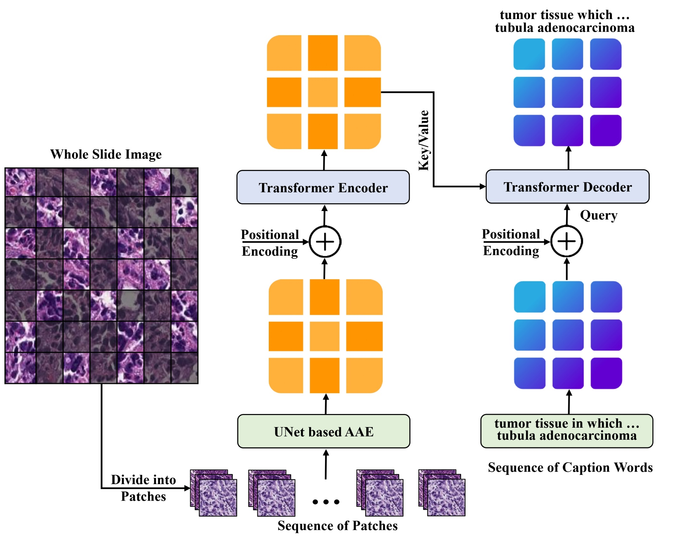
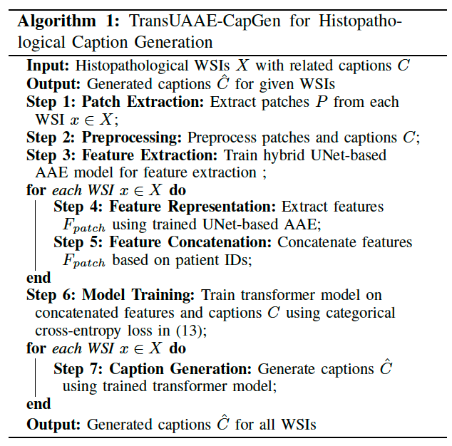
Proposed TransUAAE-CapGen Architecture
Fig. 4. Architecture of our proposed TransUAAE-CapGen model for histopathological caption generation.

Slide 7
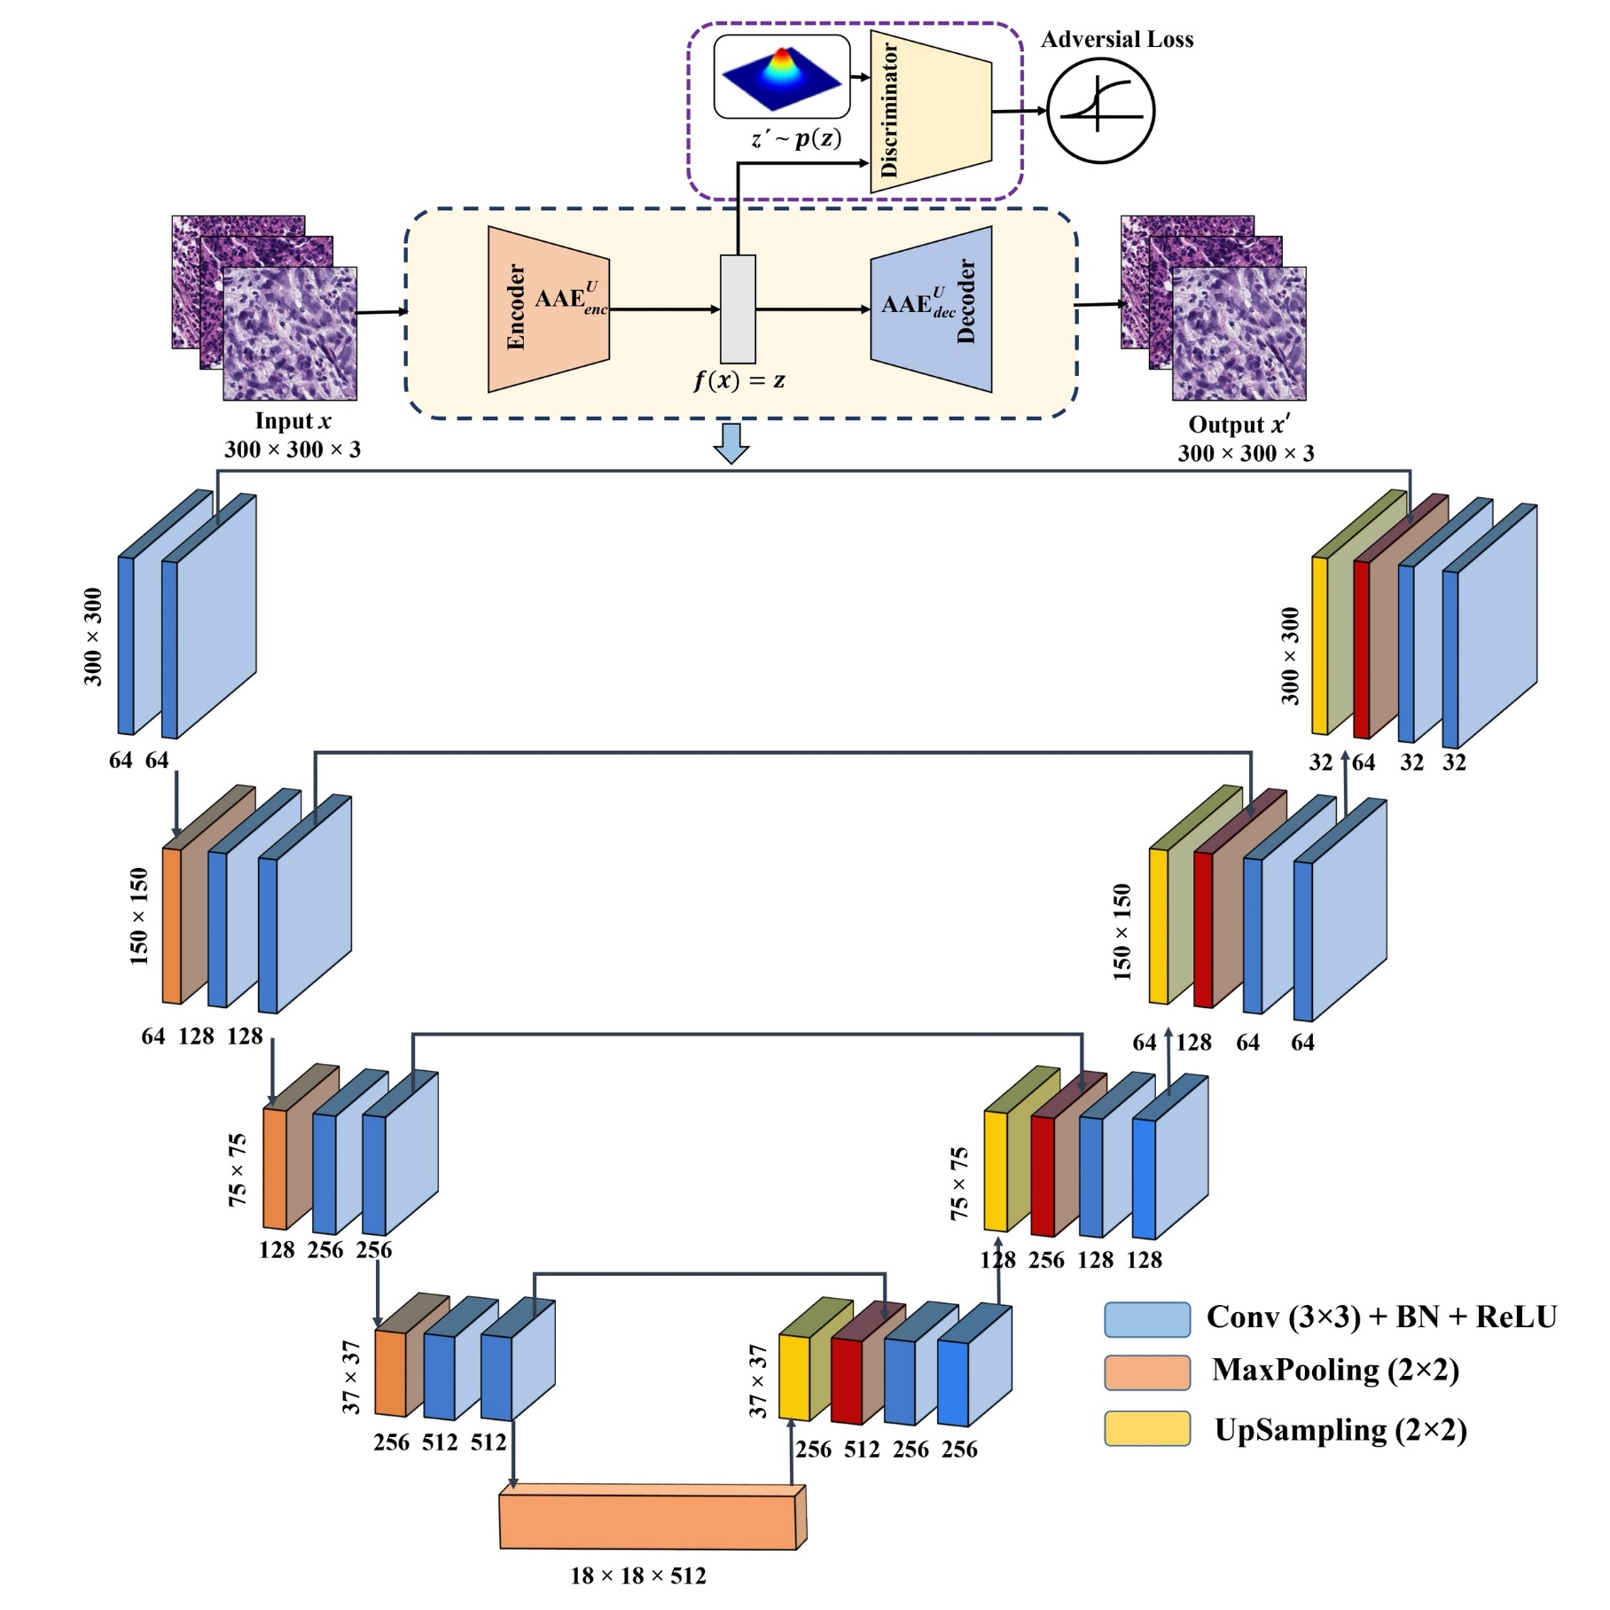
UNet-Based AAE Architecture
Fig. 5. Architecture of our proposed hybrid UNet-based AAE model for feature extraction.

Slide 8
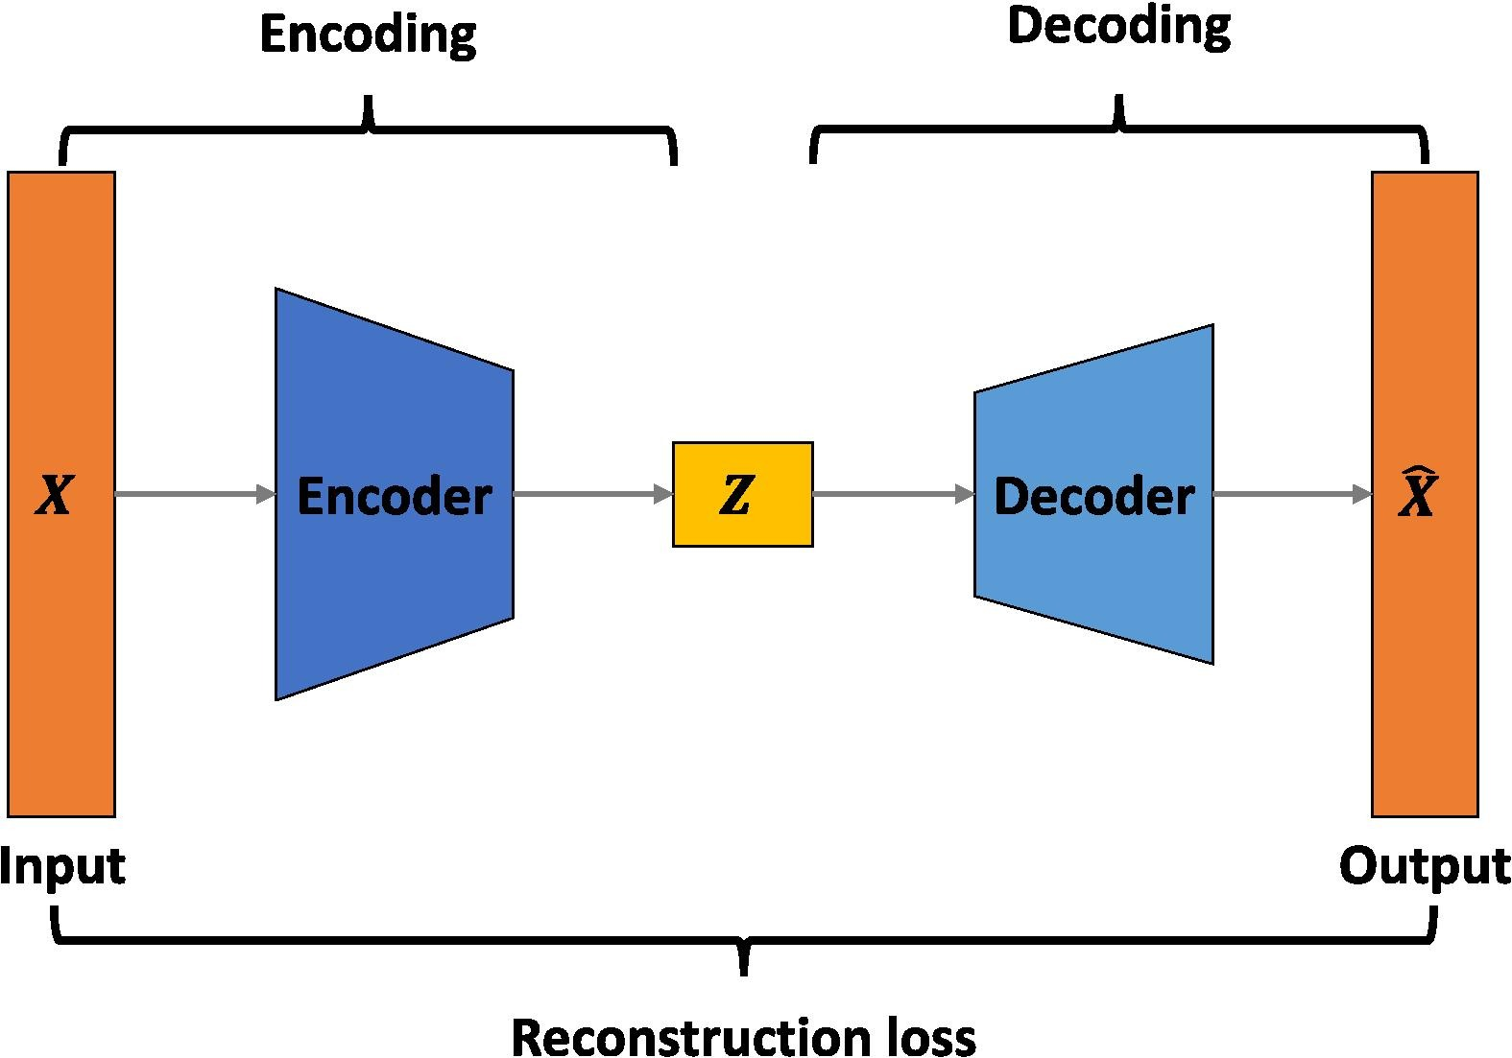
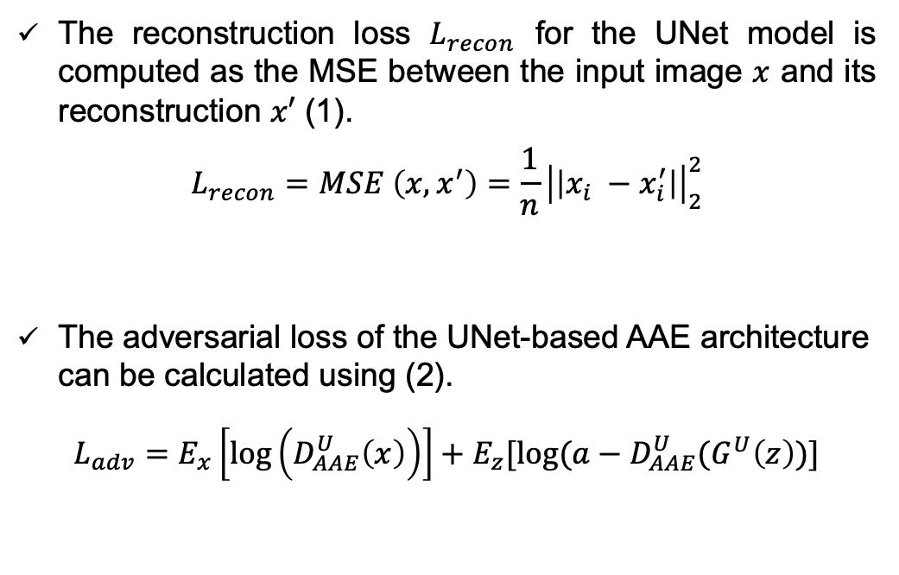
UNet-Based AAE Architecture (Cont’d)
AAE uses adversarial training to align its latent space with a prior distribution, and when combined with UNet, it captures both local and global features for improved generalization to unseen data
The reconstruction loss $L_{recon}$ for the UNet model is computed as the MSE between the input image $x$ and its reconstruction $x′$ (1).
$$L_{recon}=MSE \left(x, x^{′}\right)=\frac{1}{n}{\left|\left|x_{i} −x_{i}^{′}\right|\right|}_{2}^{2}$$
The adversarial loss of the UNet-based AAE architecture can be calculated using (2).
$L_{adv}=E_{x}\left[\log\left(D_{AAE}^{U}\left(x\right)\right)\right]+E_{z}[log⁡(a−D_{AAE}^{U}(G^{U}\left(z\right))]$
Fig. 6. Architecture of adversarial autoencoder for feature extraction and output generation.
Energy & Buildings 285 (2023): 112876

Slide 9
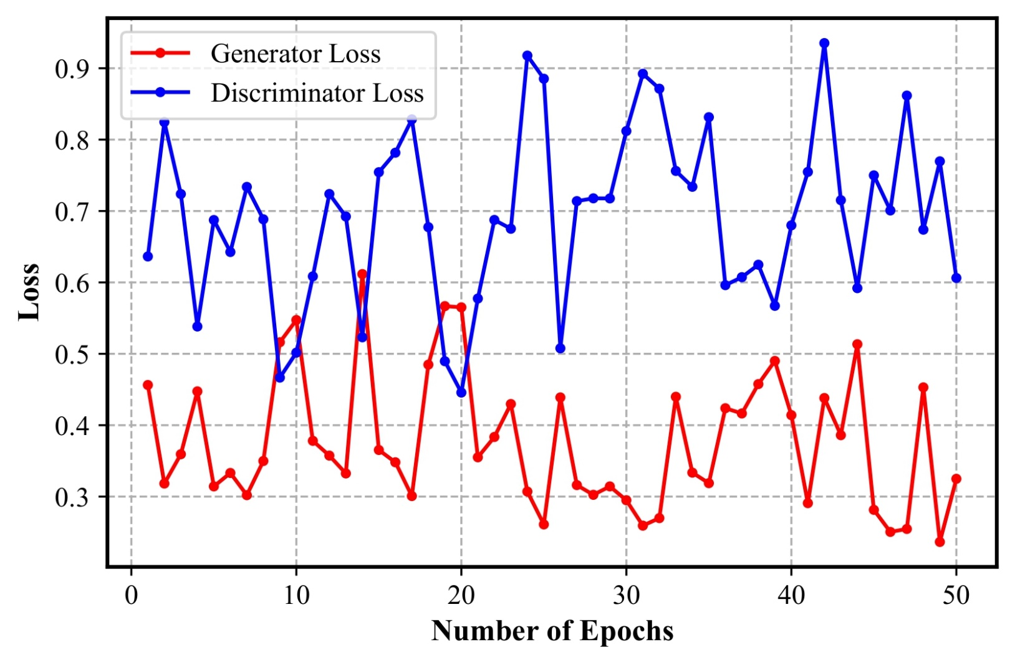
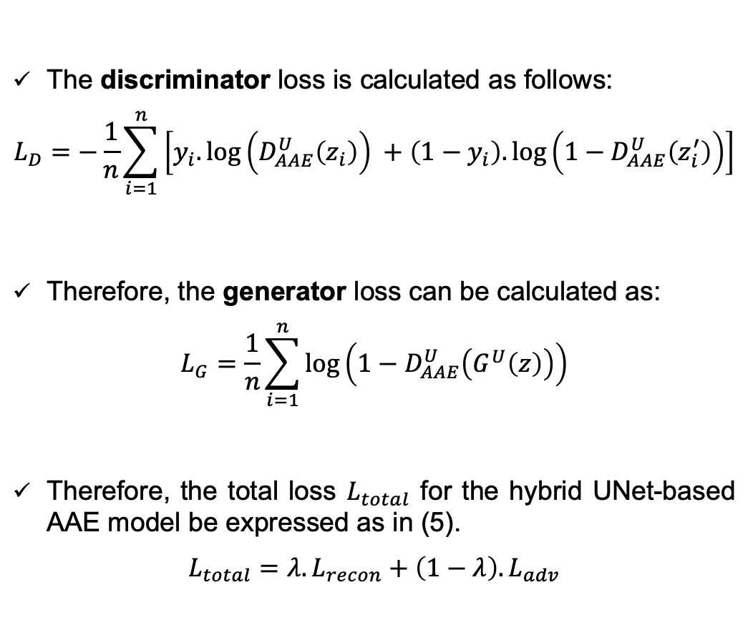
UNet-Based AAE Architecture (Cont’d)
The discriminator loss is calculated as follows:
$$L_{D}=−\frac{1}{n}\sum_{i=1}^{n}{\left[y_{i}.\log\left(D_{AAE}^{U}\left(z_{i}\right)\right) +\left(1−y_{i}\right).\log\left(1−D_{AAE}^{U}\left(z_{i}^{′}\right)\right)\right]}$$
Therefore, the generator loss can be calculated as:
$$L_{G}=\frac{1}{n}\sum_{i=1}^{n}{\log\left(1−D_{AAE}^{U}\left(G^{U}\left(z\right)\right)\right)}$$
Therefore, the total loss $L_{total}$ for the hybrid UNet-based AAE model be expressed as in (5).
$$L_{total}=λ.L_{recon}+\left(1−λ\right).L_{adv}$$
Fig. 7. The loss curve of the training set varies with the number of epochs of our proposed adversarial-UNet encoder.

Slide 10
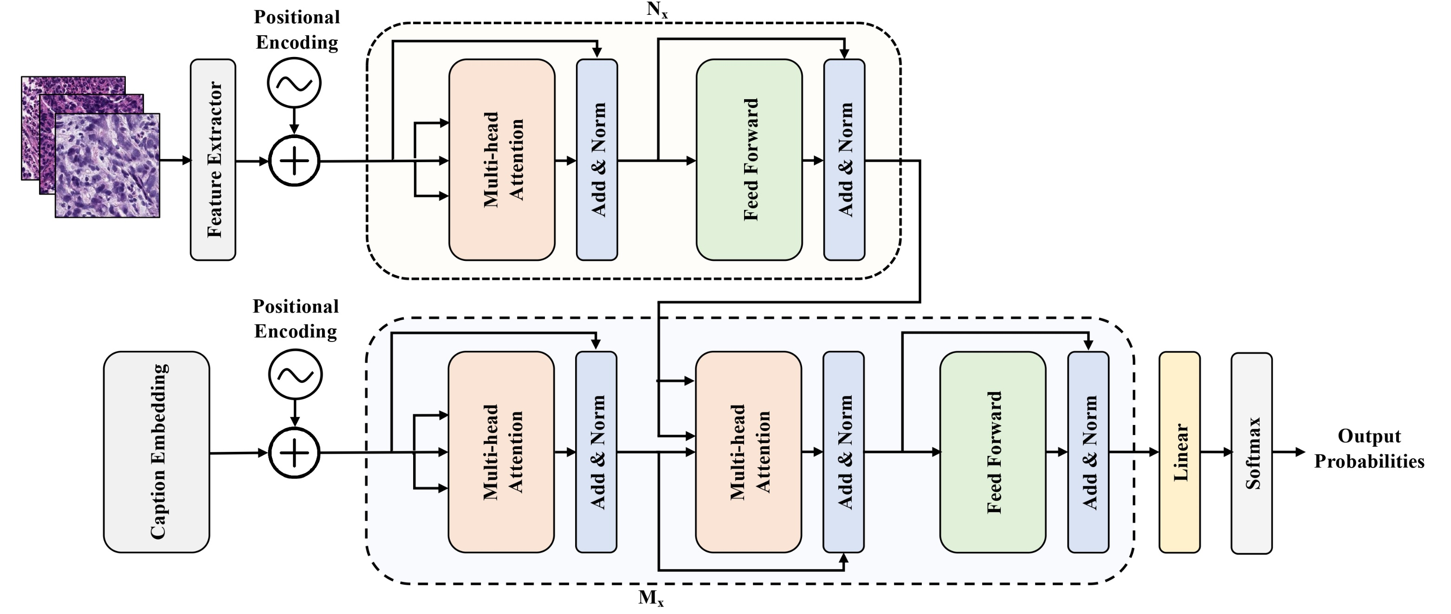
Caption Generator through Transformer
Fig. 8. Architecture of the transformer model for caption generation.

Slide 11
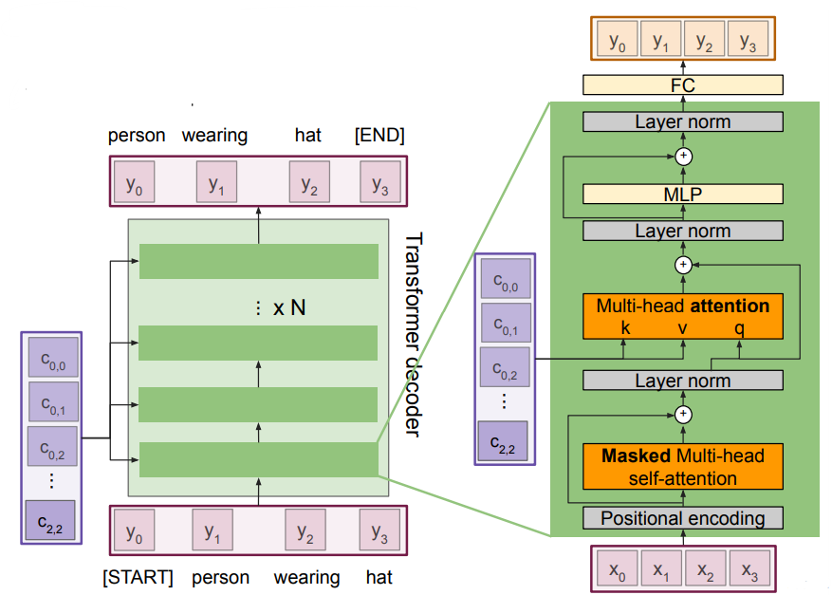
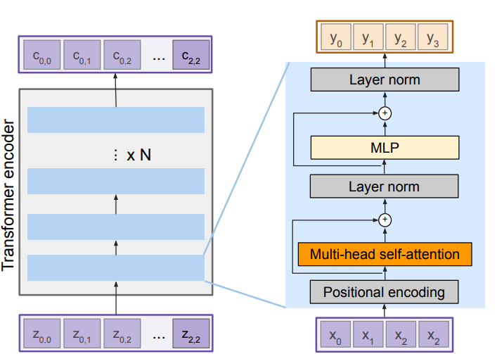
Caption Generator through Transformer (Cont’d)
Transformer Encoder Block:
For Inputs: Set of extracted features x
Outputs: Set of vectors y.
Self-attention is the only interaction between vectors.
Layer norm and MLP operate independently per vector.
Transformer Decoder Block:
For Inputs: Set of vector x and set of context vector c
Outputs: Set of vectors y.
Masked Self-attention only interacts with past inputs.
Advances in Neural Information Processing Systems, 2017: 1-11

Slide 12
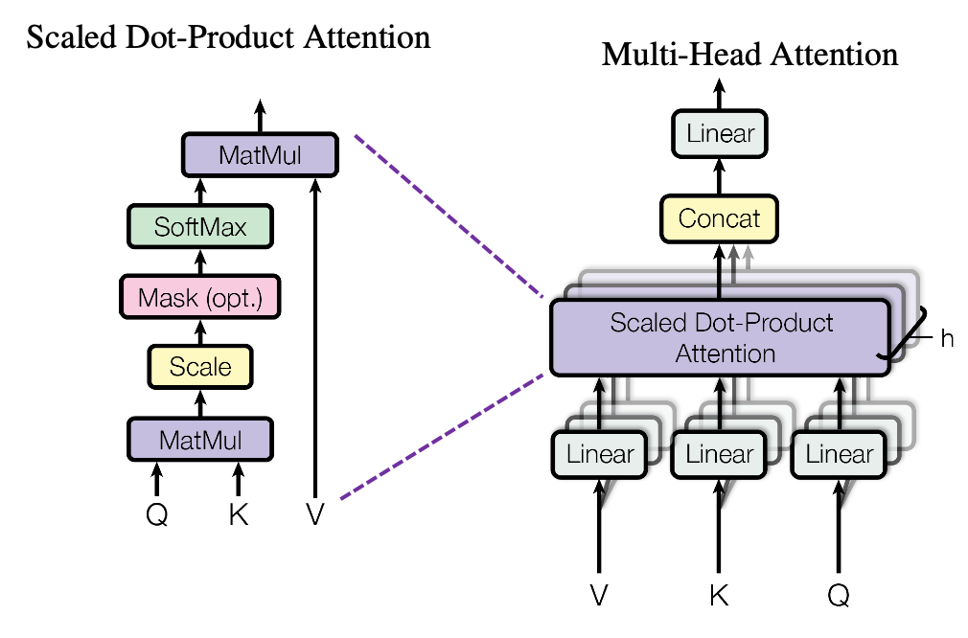
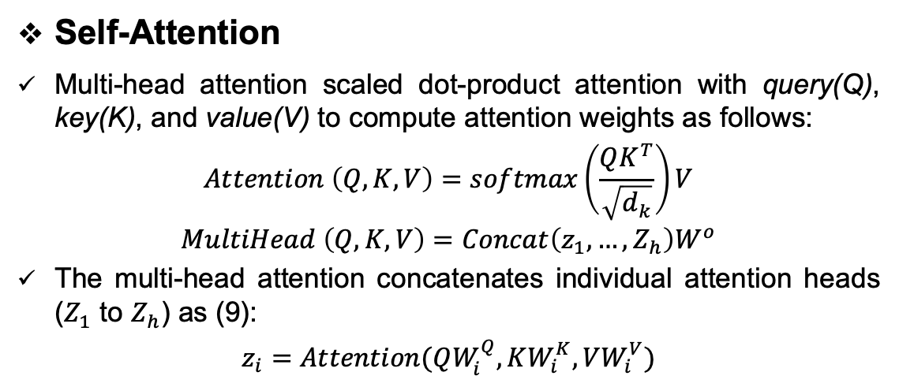
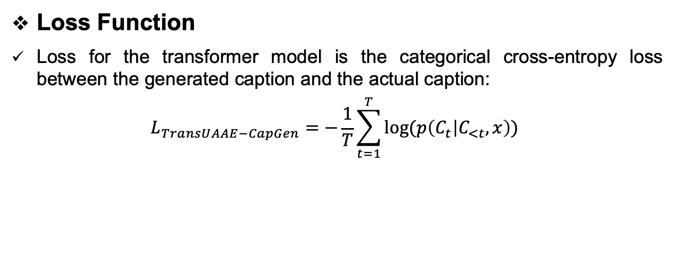
Caption Generator through Transformer (Cont’d)
Self-Attention
Multi-head attention scaled dot-product attention with query(Q), key(K), and value(V) to compute attention weights as follows:
$$Attention \left(Q, K, V\right)=softmax\left(\frac{QK^{T}}{\sqrt{d_{k}}}\right)V$$
$$MultiHead \left(Q, K, V\right)=Concat\left(z_{1},…,Z_{h}\right)W^{o}$$
The multi-head attention concatenates individual attention heads ($Z_{1}$ to $Z_{h}$) as (9):
$$z_{i}=Attention(QW_{i}^{Q}, KW_{i}^{K}, VW_{i}^{V})$$
Loss Function
Loss for the transformer model is the categorical cross-entropy loss between the generated caption and the actual caption:
$$L_{TransUAAE−CapGen}=−\frac{1}{T}\sum_{t=1}^{T}{log⁡(p\left(C_{t} | C_{<t},x\right))}$$

Slide 13
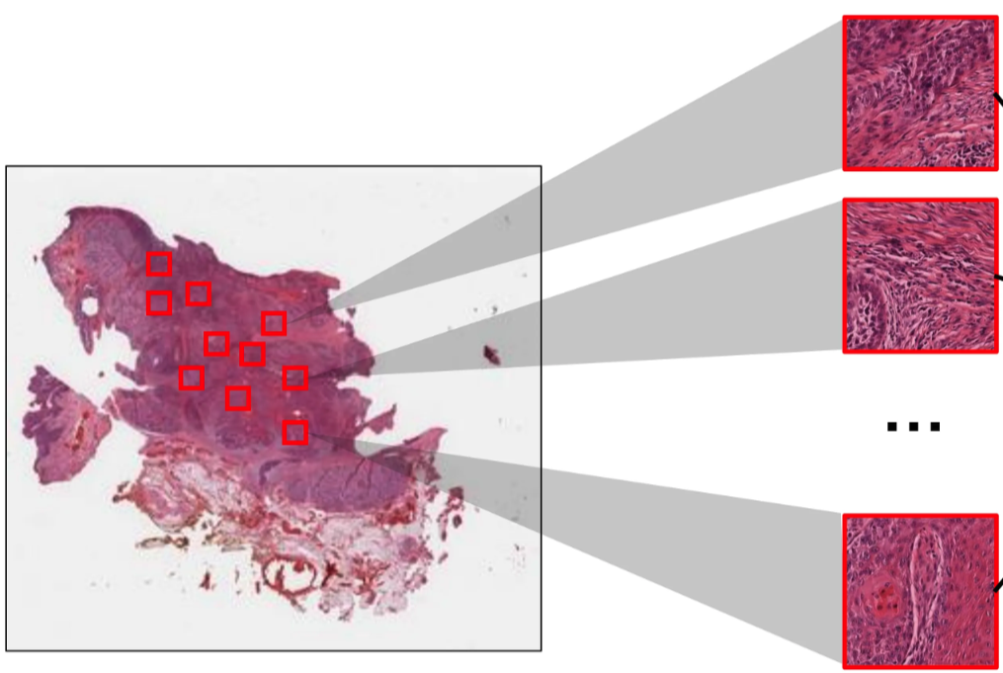
Experimental Result Analysis
Dataset Collection and Description
PatchGastricADC22 Dataset: Stomach adenocarcinoma endoscopic biopsy samples images, paired with histopathological captions.
991 whole slide images with 262,777 extracted patches.
Each patch is 300 × 300 pixels in dimension.
Patches are aligned with corresponding histopathological captions extracted from diagnostic reports.
Patches
Whole Slide Image
Caption: atypical epithelium cells with and proliferating atypical forming solid tubular observed is observed moderately Differentiated adenocarcinoma solid
Proceedings of Machine Learning Research (2022):1235-1250

Slide 14
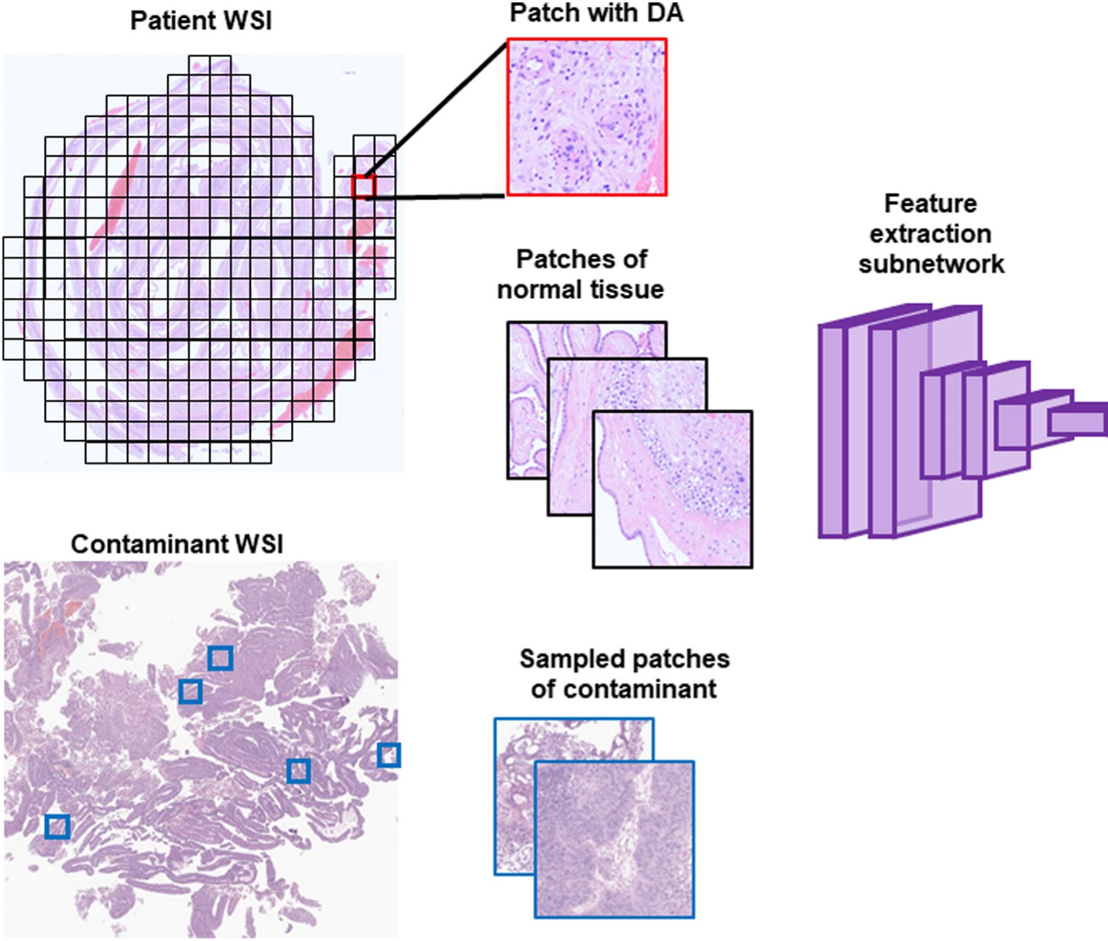
Experimental Result Analysis (Cont’d)
Dataset Preparation & Feature Extraction
The dataset is divided into training, validation, and testing sets in a ratio of 7:1:2, comprising 688, 100, and 203 slides.
Initially, EfficientNetB3 and DenseNet121, pretrained model on ImageNet, are used to extract features from their penultimate layers.
Therefore, our proposed hybrid UNet-based AAE model the extracted features output for a single WSI.
Fig. 10. Feature extraction from WSI patches using pretrained models
The Breast 66 (2022):183-190

Slide 15
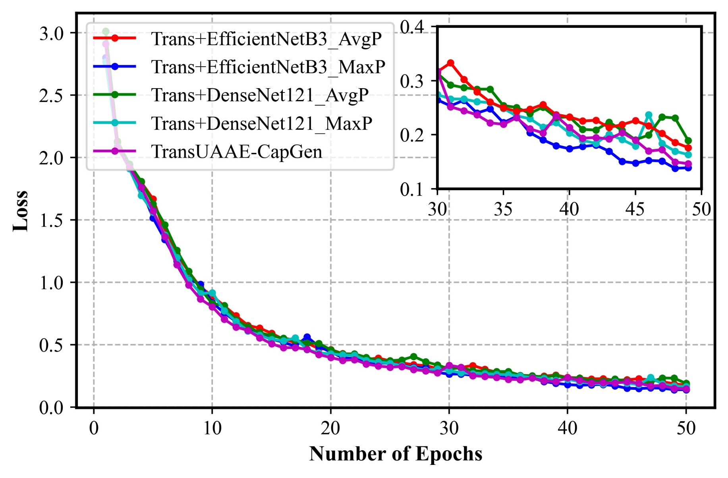
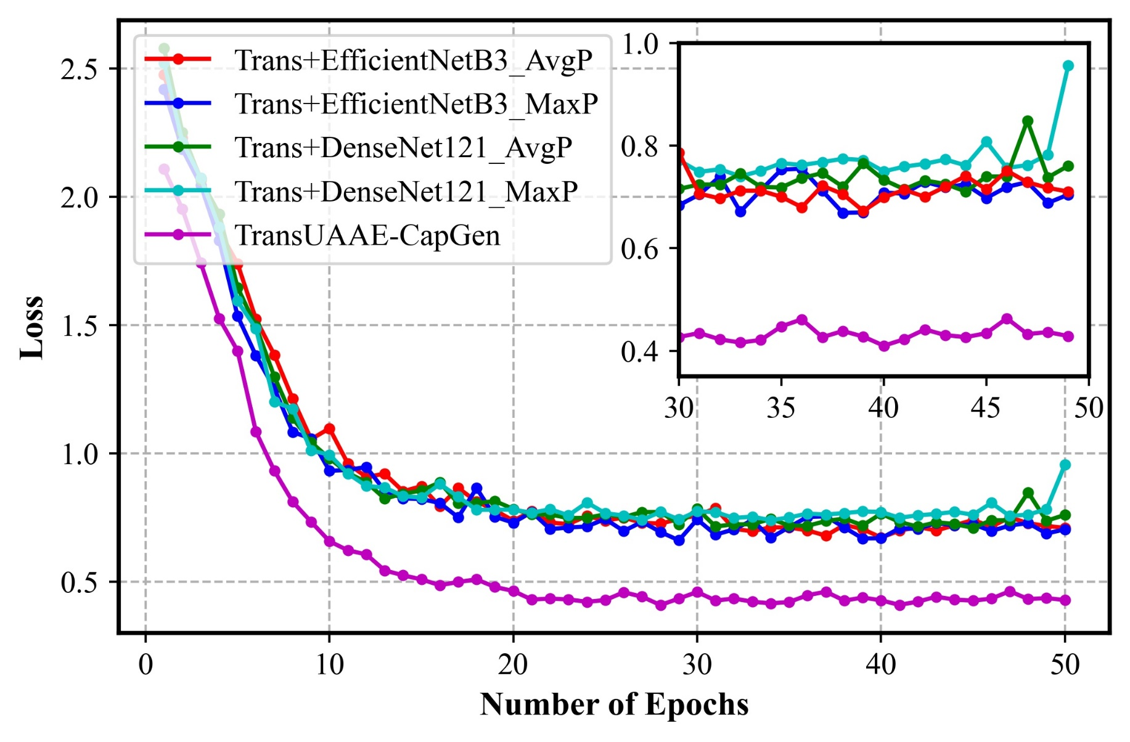
Experimental Result Analysis (Cont’d)
Quantitative Results
(a)
(b)
Fig. 11. Loss values of the proposed TransUAAE-CapGen approach along with two baseline feature extraction models. (a) Training (b) Validation.

Slide 16
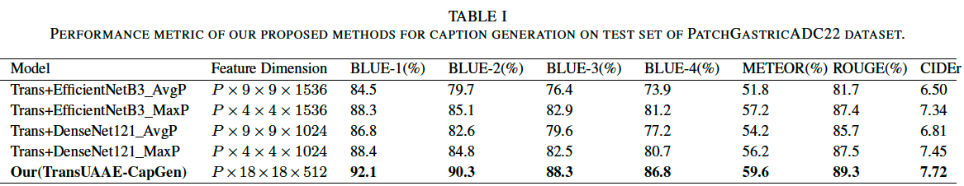
Experimental Result Analysis (Cont’d)
Quantitative Results (Cont’d)
The baseline models using EfficientNetB3 and DenseNet121 with AvgP and MaxP achieved BLUE-4 scores between 73.9% and 81.2%
The TransUAAE-CapGen model achieved significant improvements compared to Trans+EfficientNetB3 and Trans+DenseNet121 models.

Slide 17
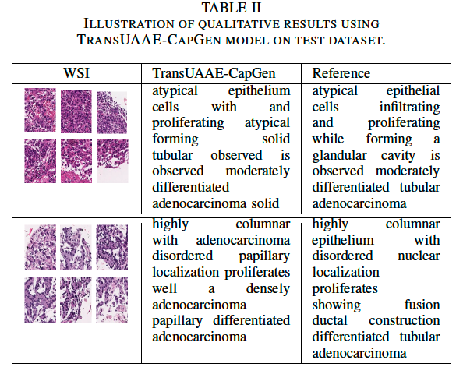
Experimental Result Analysis (Cont’d)
Qualitative Results
Both WSI images were randomly selected from the test set.
The TransUAAE-CapGen model effectively generates captions for histopathological images closely matching reference captions.
The model shows proficiency in capturing detailed pathological features comparable to expert descriptions.

Slide 18
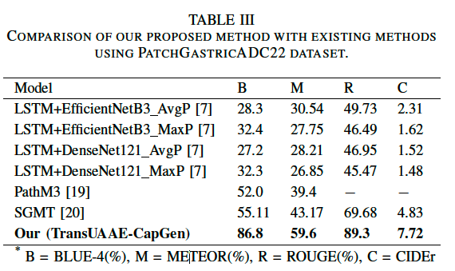
Experimental Result Analysis (Cont’d)
Comparison with the State-of-the-Art
Our proposed approach outperformed the current literature with respect to BLUE, METEOR, ROUGE, and CIDEr scores.

Slide 19
Conclusion
We proposed a TransUAAE-CapGen architecture to generate the caption from WSI patches.
The TransUAAE-CapGen model is based on a hybrid UNet-based AAE for feature extraction and a transformer for caption generation.
The transformer architecture is used for caption generation due to its superior handling of long-range dependencies and understanding of context.
The experiments show the model generates precise WSI captions, aiding healthcare professionals in better image interpretation.
Future Plan
Addressing hyperparameter sensitivity and reducing the risk of model collapse or learning instability.
Incorporating visual transformers (ViT) to enhance hierarchical feature extraction using their multi-head attention mechanism.

Slide 20
References
[1] N C. Frascarelli, N. Fusco, and G. Vago, “Artificial intelligence in diagnostic and predictive pathology,” in Artificial Intelligence for Medicine. Elsevier, 2024, pp. 81–90.
[2] L. Xu, Q. Tang, J. Lv, B. Zheng, X. Zeng, and W. Li, “Deep image captioning: A review of methods, trends and future challenges,” Neurocomputing, p. 126287, 2023
[3] Y. Sun, H. Wu, C. Zhu, S. Zheng, Q. Chen, K. Zhang, Y. Zhang, X. Lan, M. Zheng, J. Li et al., “Pathmmu: A massive multimodal expert-level benchmark for understanding and reasoning in pathology,” arXiv preprint arXiv:2401.16355, 2024.
[4] N. Dimitriou, O. Arandjelovi´c, and P. D. Caie, “Deep learning for whole slide image analysis: an overview,” Frontiers in medicine, vol. 6, p. 264, 2019
[5] S. Elbedwehy, T. Medhat, T. Hamza, and M. F. Alrahmawy, “Enhanced descriptive captioning model for histopathological patches,” Multimedia Tools and Applications, vol. 83, pp. 36 645–36 664, 2024.
[6] T. Ghandi, H. Pourreza, and H. Mahyar, “Deep learning approaches on image captioning: A review,” ACM Computing Surveys, vol. 56, no. 3, pp. 1–39, 2023.
[7] M. Tsuneki and F. Kanavati, “Inference of captions from histopathological patches,” in International Conference on Medical Imaging with Deep Learning. PMLR, 2022, pp. 1235–1250.
[8] MA. K. Allada, Y. Wang, V. Jindal, M. Babee, H. R. Tizhoosh, and M. Crowley, “Analysis of language embeddings for classification of unstructured pathology reports,” in 2021 43rd Annual International Conference of the IEEE Engineering in Medicine & Biology Society (EMBC). IEEE, 2021, pp. 2378–2381.
[9] A. Selivanov, O. Y. Rogov, D. Chesakov, A. Shelmanov, I. Fedulova, and D. V. Dylov, “Medical image captioning via generative pretrained transformers,” Scientific Reports, vol. 13, no. 1, p. 4171, 2023.
[10] R. Zhang, C. Weber, R. Grossman, and A. A. Khan, “Evaluating and interpreting caption prediction for histopathology images,” in Machine Learning for Healthcare Conference. PMLR, 2020, pp. 418–435.

Slide 21


Slide 22
UNet-Based AAE Architecture (Cont’d)
Training Details: The model is trained over 50 epochs using 30,000 histopathological image samples.
Model Architecture: The UNet-based AAE has a latent space with dimensions of 18 × 18 × 512.
Feature Extraction: Features are extracted from the images using the trained UNet-based AAE encoder..
Final Feature Dimension: The final feature dimensions for each WSI with P patches are P × 18 × 18 × 512.

Slide 23
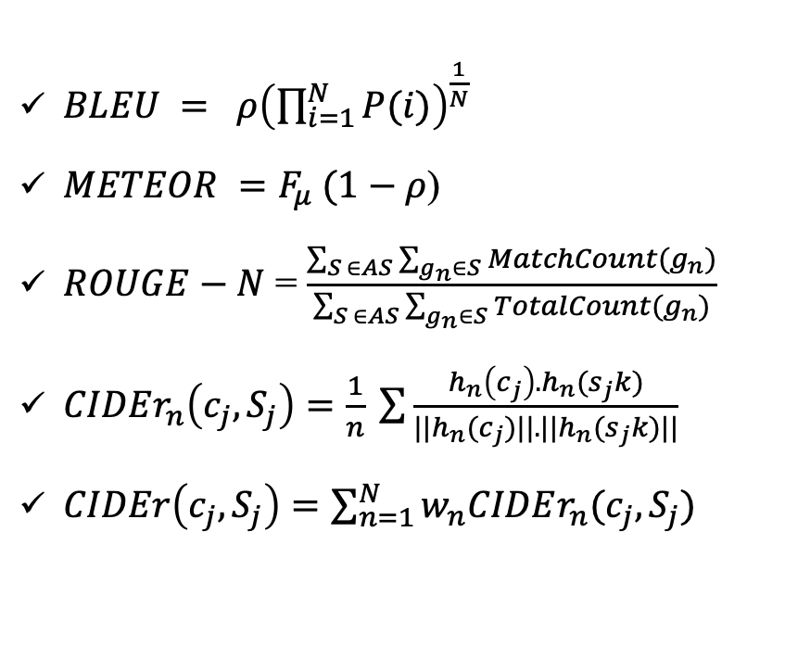
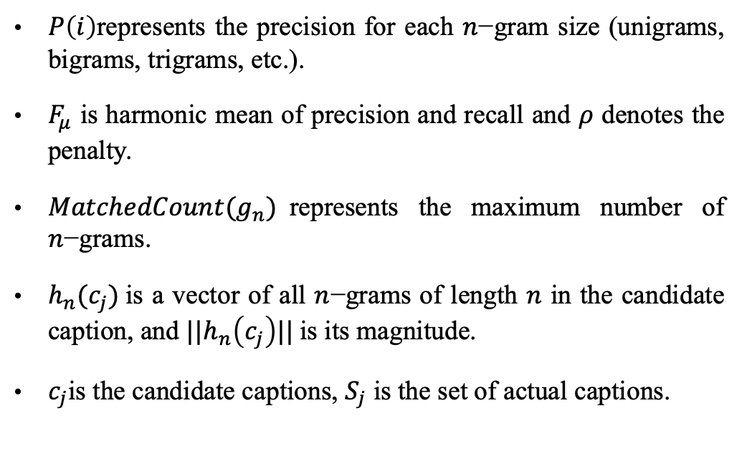
Evaluation Protocol
Statistical measures to evaluate the performance of the proposed TransUAAE-CapGen architecture
$BLEU = ρ{\left(\prod_{i=1}^{N}{P(i)}\right)}^{\frac{1}{N}}$
$METEOR =F_{μ} (1−ρ$)
$ROUGE−N$ = $\frac{\sum_{S ∈AS}{\sum_{g_{n}∈S}{MatchCount(g_{n})}}}{\sum_{S ∈AS}{\sum_{g_{n}∈S}{TotalCount(g_{n})}}}$
$CIDEr_{n}\left(c_{j}, S_{j}\right)=\frac{1}{n} \sum{\frac{h_{n}\left(c_{j}\right). h_{n}(s_{j}k)}{||h_{n}(c_{j})||.||h_{n}(s_{j}k)||}}$
$CIDEr\left(c_{j}, S_{j}\right)=\sum_{n=1}^{N}{w_{n}CIDEr_{n}(c_{j}, S_{j})}$
$P\left(i\right)$represents the precision for each $n$−gram size (unigrams, bigrams, trigrams, etc.).
$F_{μ}$ is harmonic mean of precision and recall and $ρ$ denotes the penalty.
$MatchedCount(g_{n})$represents the maximum number of $n$−grams.
$h_{n}(c_{j})$is a vector of all $n$−grams of length $n$ in the candidate caption, and ${||h}_{n}\left(c_{j}\right)||$is its magnitude.
$c_{j}$is the candidate captions, $S_{j}$ is the set of actual captions.

Slide 24
Experimental Result Analysis
Experimental Environment
We performed our experiments on a high-computing machine.
Configuration: (Apple M3 Pro chip with 11‑core CPU, 14‑core GPU and 16‑core Neural Engine).
All the experiments were conducted using Python(v3.11.8) and PyTorch (v2.4.0).
Hyper-parameter Settings
We performed the experiments for 50 epochs to train the proposed architecture.
Batch size was set to 16.
Learning rate was set to 0.001
Weight decay was epoch/length(train)
Adam was used as optimizer.
Categorical cross-entropy was used as the loss function.

